Slide 1
P2P Communication between NodeMCUs
Programming Lab – PC503
Group Members:
ABHAY GOYAL (202211034)
HARSH VARSHNEY (202211001)

Slide 2
Motivation
The problem of communication exists -
In mountains, hilly areas (within an area and to other areas),
Between the outside and inside areas of tunnels, and
Remote, rural and forest areas.
So, we got a motivation to develop a system to solve this problem and improve connectivity in such areas.

Slide 3
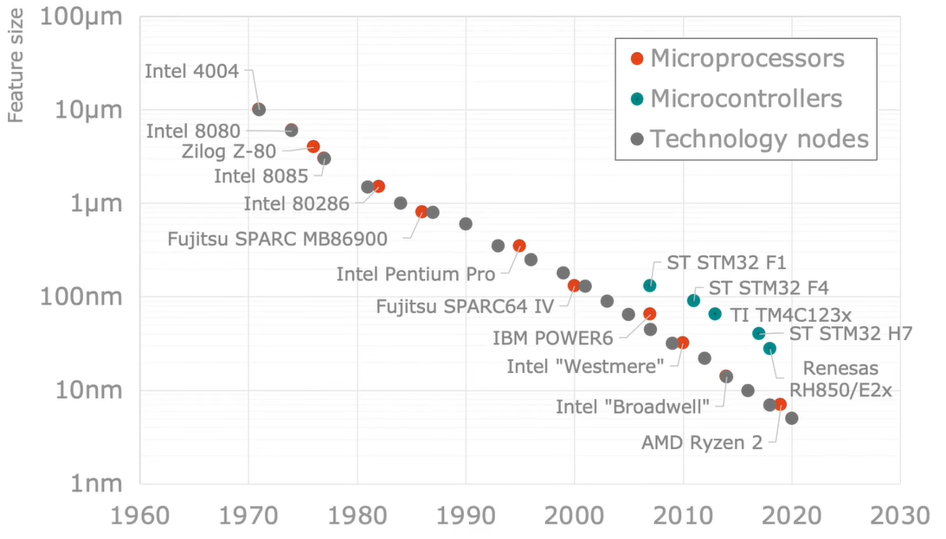
State of the Art Technology
Image Source- https://bit.ly/3MhRN6W

Slide 4
Project Objective
2-way P2P communication between 2 NodeMCUs.
2-way P2P communication between multiple NodeMCUs for increased connectivity and range.

Slide 5
Components Required
Frontend (Hardware)
NodeMCU Modules
USB Cable
Connecting wires
Breadboard (in development phase)
Custom PCB (in implementation phase)
Backend (Software)
Arduino IDE (For Arduino Programming)
Thonny IDE (For MicroPython Programming)

Slide 6
NodeMCU
An open-source firmware and development kit that helps us to prototype our IoT product within a few Lua script lines.
The name "NodeMCU" combines “Node" (connecting point) and "MCU" (micro-controller unit).
NodeMCU Development board features Wi-Fi capability, analog pins, digital pins, and serial communication protocols.
It uses many open-source projects, such as lua-cjson, MicroPython, Arduino and SPIFFS.

Slide 7
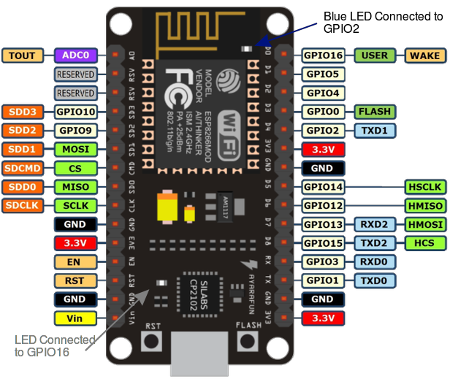
NodeMCU V3 Pin Diagram

Slide 8
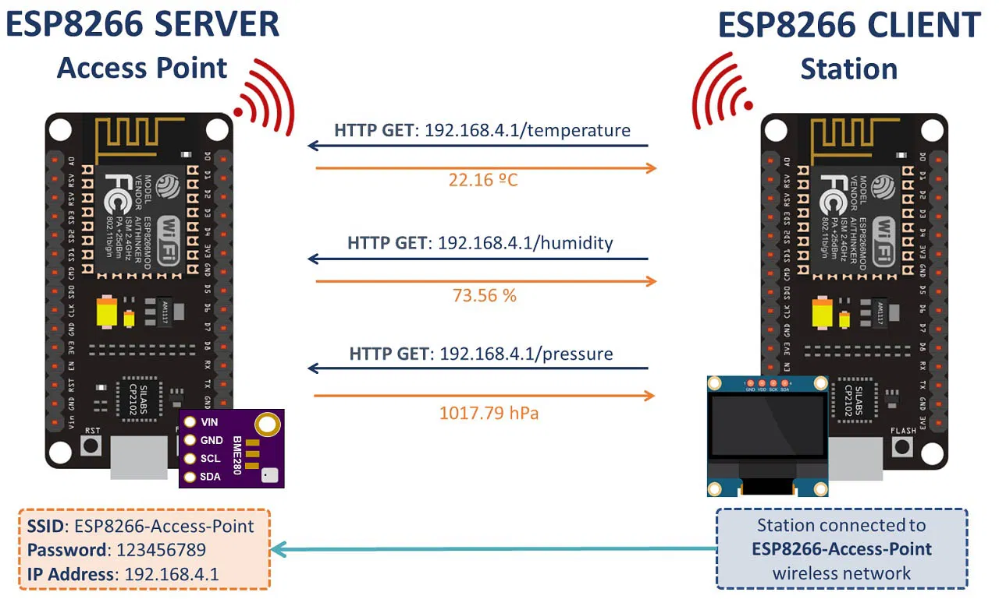
One-way Communication Between Two NodeMCUs
Image Source- https://bit.ly/3ywa1fp

Slide 9
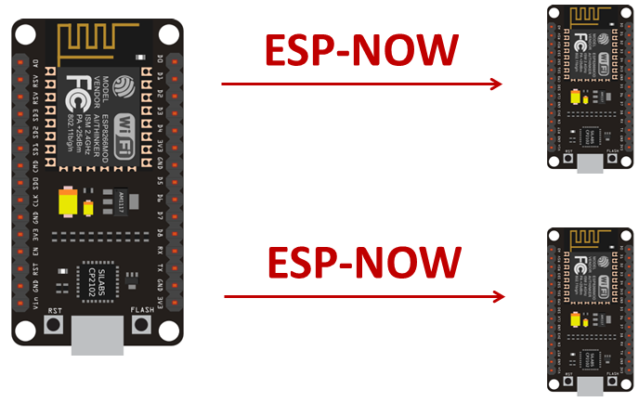
One-to-many Communication of NodeMCUs
Image Source- https://bit.ly/3CLA6cM

Slide 10
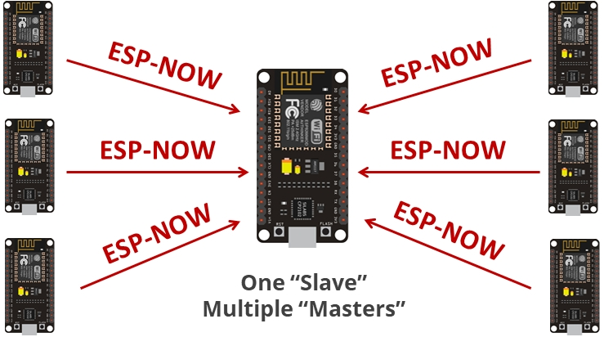
Many-to-one Communication of NodeMCUs
Image Source- https://bit.ly/3MiOOva

Slide 11
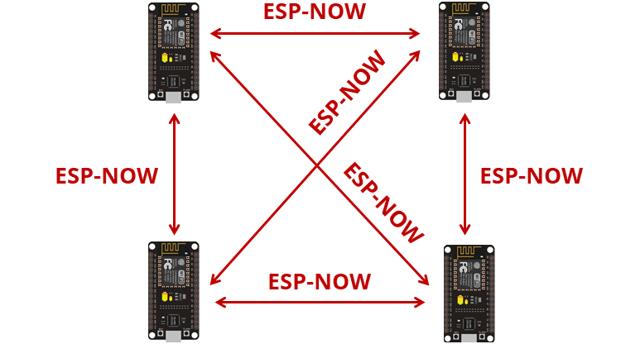
Mesh Communication of NodeMCUs
Image Source- https://bit.ly/3CkdRJJ

Slide 12
Flow Chart
Check if module connected to internet
Send data to Interface
Output signal to server connected to internet
Input signal from the first module
Yes
No
Send signal to next module
Check if module connected to internet
No
Yes

Slide 13
Test Code - 1
//Arduino test code for printing IP assigned by Router.
#include "ESP8266WiFi.h"
// WiFi parameters to be configured
const char* ssid = "HARRY-Redmiy2"; // Write here your router's username
const char* password = "9837080356"; // Write here your router's passward
void setup(void)
{
Serial.begin(9600);
// Connect to WiFi
WiFi.begin(ssid, password);
// while wifi not connected yet, print '.'
// then after it connected, get out of the loop
while (WiFi.status() != WL_CONNECTED) {
delay(500);
Serial.print(".");
}
//print a new line, then print WiFi connected and the IP address
Serial.println("");
Serial.println("WiFi connected");
// Print the IP address
Serial.println(WiFi.localIP());
}
void loop() {
// Nothing
}

Slide 14
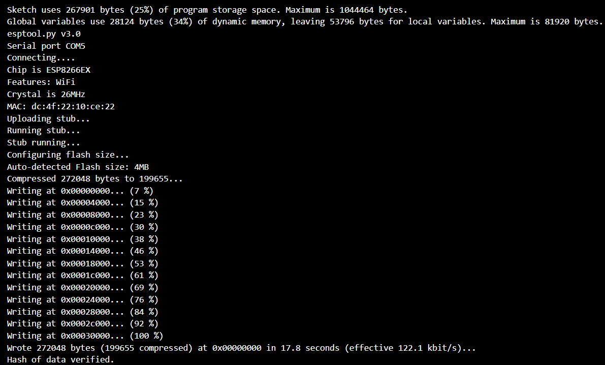
Test Code - 1 Output

Slide 15
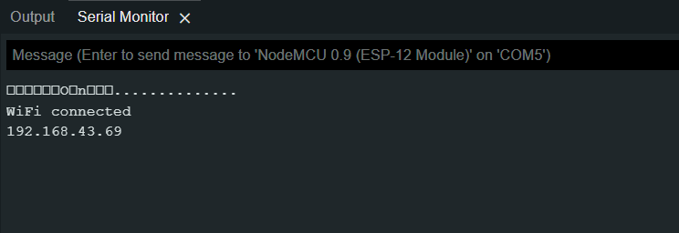
Test Code - 1 Output (Cont…)

Slide 16
Test Code - 2 Algorithm
# Test code using MicroPython on NodeMCU for GPIO Interface
Activate.WLAN()
Enable.ESPNOW()
Enable.ESPNOW.P2P()
peer = b'\xa0\x20\xa6\x14\x68\xc6’
ESPNOW.add_peer(peer)
def SEND():
ESPNOW.send(peer, data)
print("Data Sent successfully.")
def RECV():
while True:
host, msg = ESPNOW.recv()
print("Data Received Successfully")
break

Slide 17
Observations
Writing code in MicroPython requires less memory as compared to Arduino IDE code.
MicroPython provides a vast collection of libraries as compared to Arduino IDE.
MicroPython code requires interpreter while Arduino IDE code is directly compiled and uploaded.
MicroPython code can even be run using REPL without uploading it on device.
Serial Communication through MicroPython is relatively easy as compared to Arduino IDE.

Slide 18
Results
1 – way communication between 2 NodeMCUs successfully established using both Arduino and MicroPython.
2 – way communication between 2 NodeMCUs successfully established using both Arduino and MicroPython.
Multi – way communication algorithm designed and analysed for MicroPython.

Slide 19
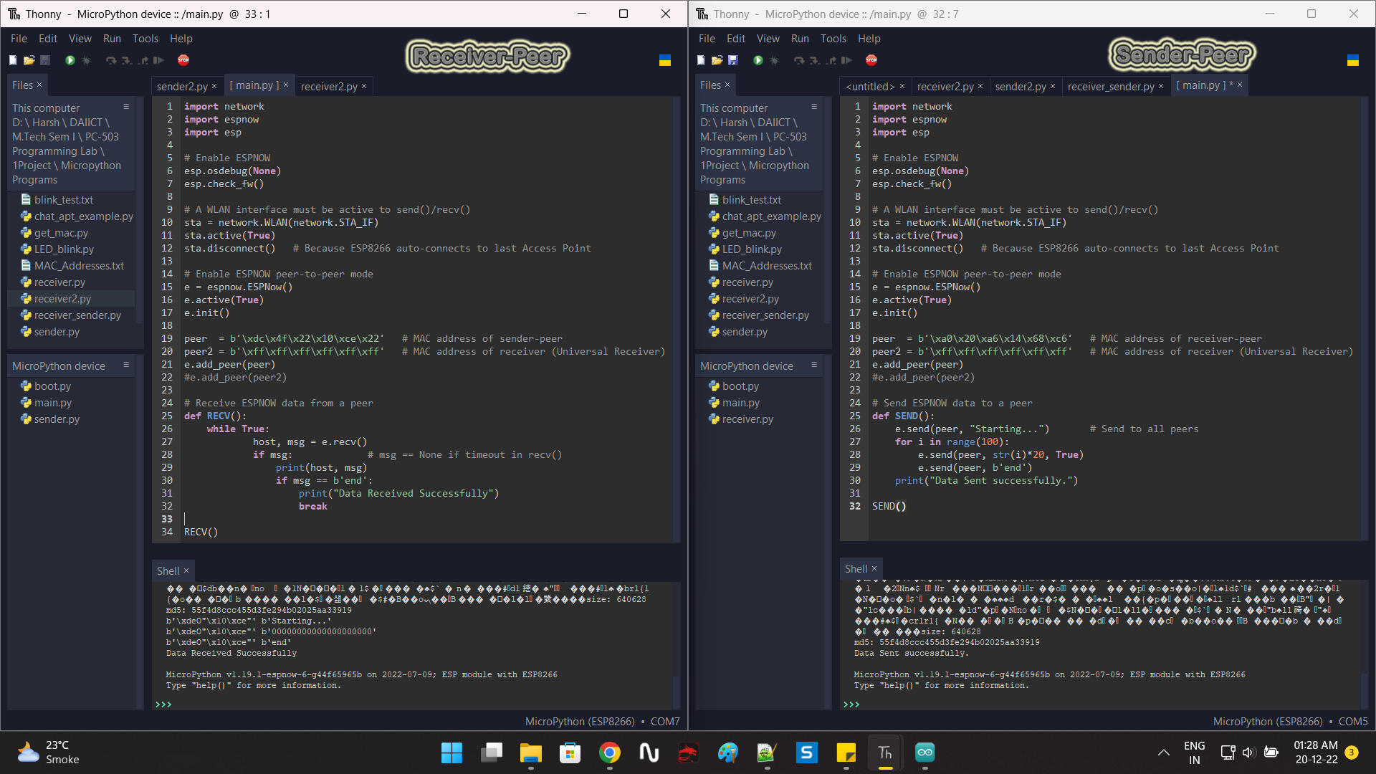
Result (Cont…)
2-way communication using MicroPython

Slide 20
Discussion
In 1-way communication, one device works as host and other as client. So, a device can either receive or send data.
In 2-way communication, either device can send or receive data.
ESP-NOW protocol is used to implement 2 – way communication.
ESP-NOW protocol can be also used for Multi – way communication or Many – to – Many communication.

Slide 21
Conclusion
By using ESP-NOW protocol, 2 – way communication was successfully established. There will be communication between two and more devices at subsequent positions without the internet.
It will help solve the connection dropout problem in tunnels or affected areas.

Slide 22
Future Work
We can go for more communication modes to make communication more effective and create a network of devices.
A local network of devices can be used in communication for emergency, relief and for disaster management purposes.

Slide 23
References
Parihar, Yogendra Singh. (2019). Internet of Things and NodeMCU A review of use of NodeMCU ESP8266 in IoT products. 6. 1085. © 2019 JETIR June 2019, Volume 6, Issue 6
P2P (Bilateral) Communication Between NodeMCU Esp8266 Boards Using Arduino IDE (doi:10.24193/subbphys.2020.08)

Slide 24
Useful Resources
https://github.com/hv-harsh/Programming_Lab_Project
https://docs.micropython.org/en/latest/esp8266/tutorial/index.html
https://github.com/espressif/esp-now
https://github.com/glenn20/micropython-espnow-images
https://github.com/micropython/micropython/tree/master/ports/esp8266
https://github.com/techiesms/ESPNOW-One-To-Many-Communication-codes

